Slide 1

Olist Store Analysis

Slide 2



DATASET
Domain
E-commerce
Project Name
Olist Store Analysis
Dataset Type
CSV Data

Slide 3




TOOLS USED:
EXCEL
MYSQL
TABLEAU
POWER BI

Slide 4

Team Members
Jitesh Narendra Vazirani
Sushmita Ramesh Kulkarni
Kolekar Udit Kumar
Vrushali Swapnil Jadhav
Sagar Shivaji Utekar
Surabhi Basant Sahoo

Slide 5
Introduction
In the rapidly evolving world of e-commerce, businesses need to leverage data analytics to remain competitive.
Olist, a Brazilian-based company, provides a platform for small and medium-sized retailers to sell their products on major e-commerce marketplaces.
This allows sellers to expand their reach without having to manage individual marketplace accounts.
Analyzing the data generated from these transactions can provide critical insights into various aspects of the business, from sales performance to customer behavior and operational efficiency.

Slide 6
KPI’s
Weekday Vs Weekend (order_purchase_timestamp) Payment Statistics
Number of Orders with review score 5 and payment type as credit card.
Average number of days taken for order_delivered_customer_date for pet_shop
Average price and payment values from customers of sao paulo city
Relationship between shipping days (order_delivered_customer_date - order_purchase_timestamp) Vs review scores.

Slide 7

There are multiple datasets associated with the Olist store, and each dataset is connected through a common column .
Data Model

Slide 8
Problem Faced by Client
Delayed Deliveries
Many orders are not delivered on time.
The actual delivery date (order_delivered_customer_date) often exceeds the estimated delivery date (order_estimated_delivery_date).
Late deliveries impact customer satisfaction and lead to negative reviews.
2. Low Customer Satisfaction
Many customers give low review_score ratings.
Possible reasons: delayed shipments, product quality issues, or poor customer service.
3. High Shipping Costs
freight_value (shipping cost) is high for certain orders.
Higher shipping costs reduce profitability for sellers.
4. Inefficient Payment Methods
Many transactions require multiple installments (payment_installments), which may indicate affordability issues.
Some customers abandon their carts due to limited payment options.
5. Poor Sales in Certain Product Categories
Some product categories have low sales (product_category_name).
Sellers might need better marketing or discounts to boost sales.

Slide 9
Steps Taken to Solve Client Problems & Benefits
Delivery Optimization: Analyzed Shipping Days and suggested efficient logistics solutions to reduce delays.
Customer Satisfaction Analysis: Studied review_score to find pain points and suggested improvement strategies.
Cost Reduction Strategies: Identified high freight_value trends and recommended optimized shipping methods.
Product Performance Analysis: Reviewed product_category_name trends to focus on high-demand items.

Slide 10
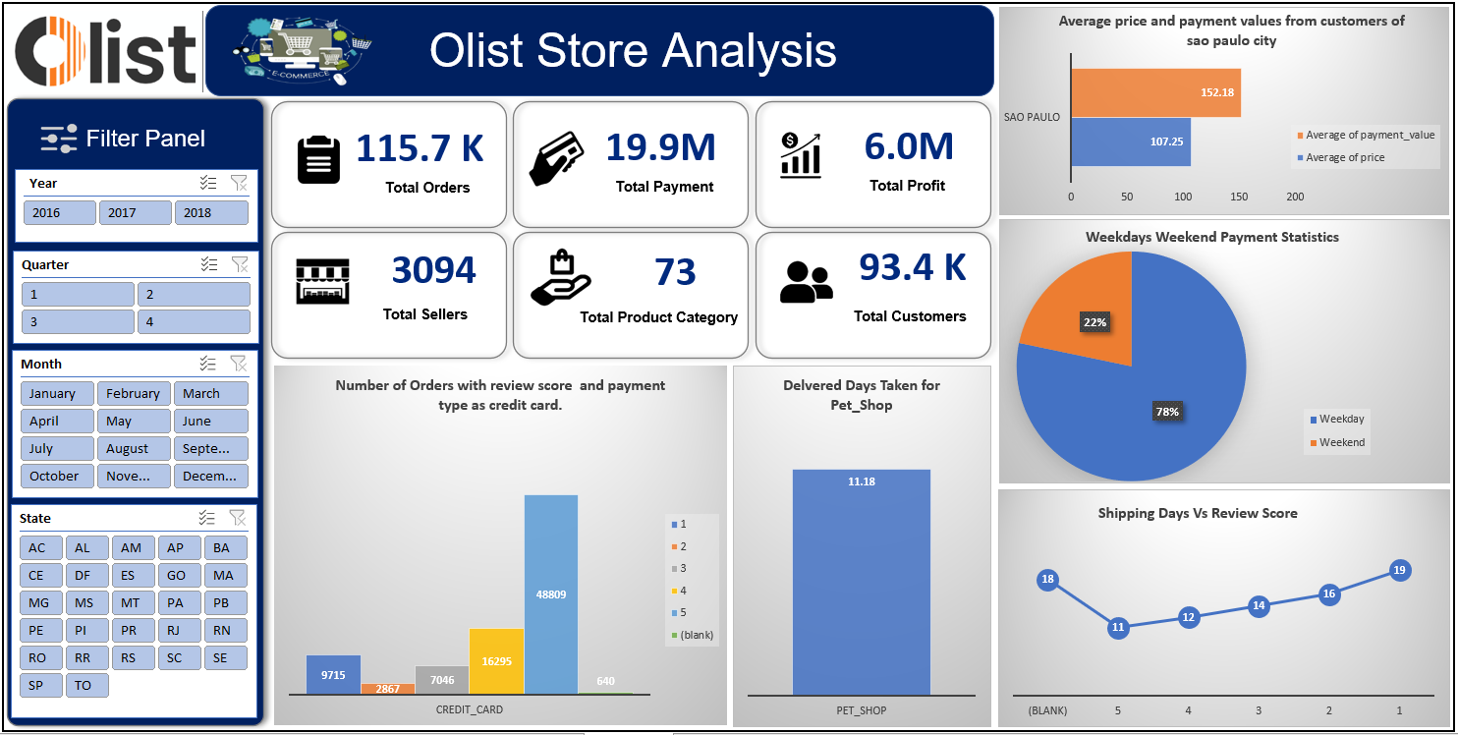
Excel Dashboard

Slide 11
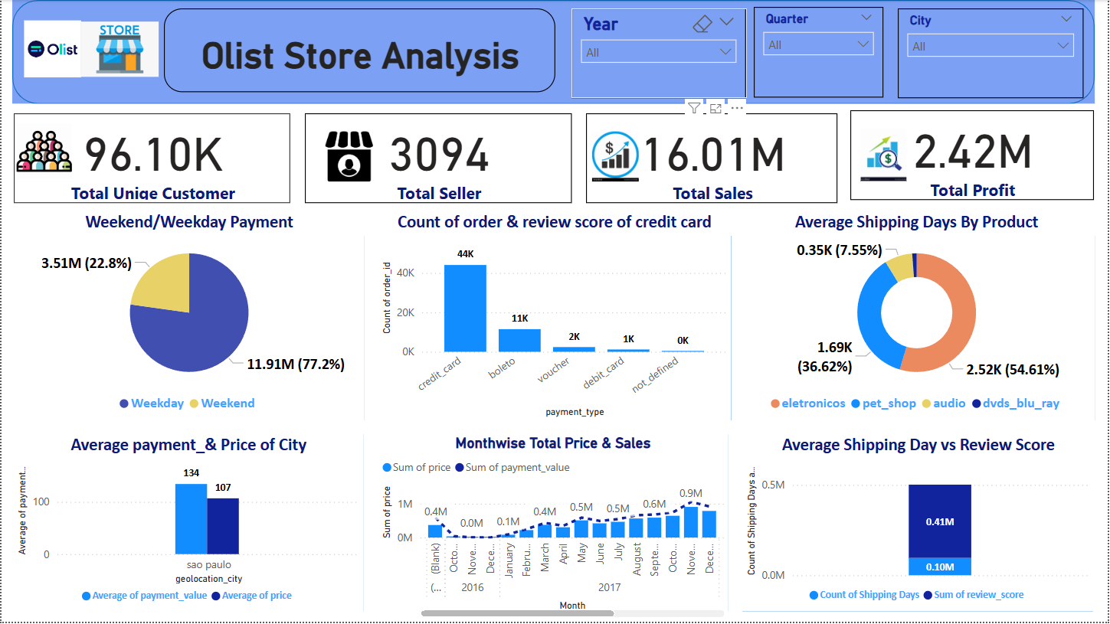
Power Bi Dashboard

Slide 12
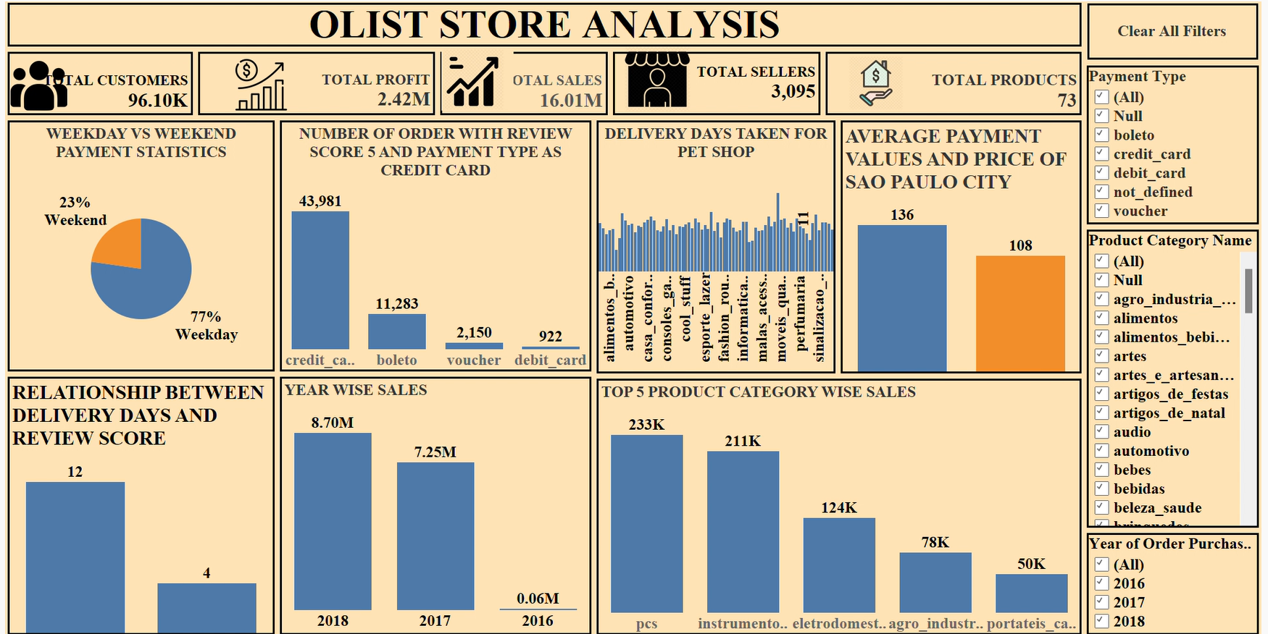
Tableau Dashboard

Slide 13
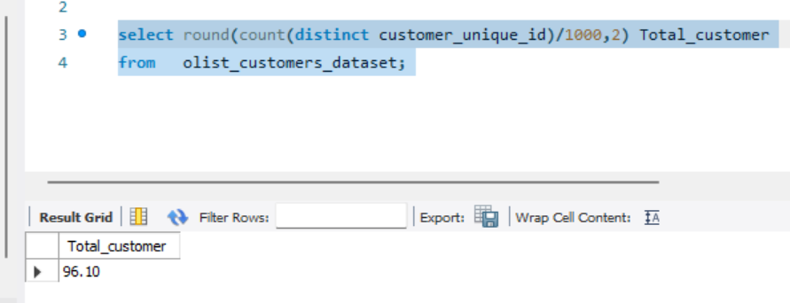
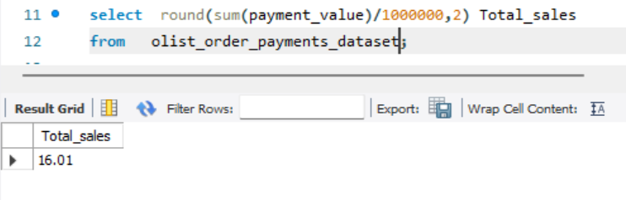
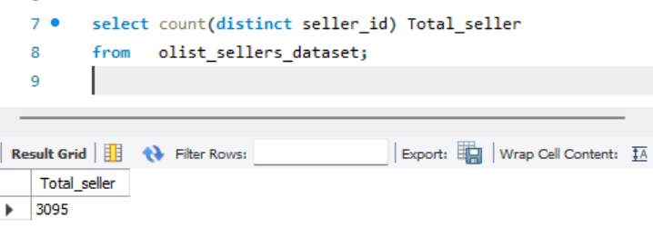
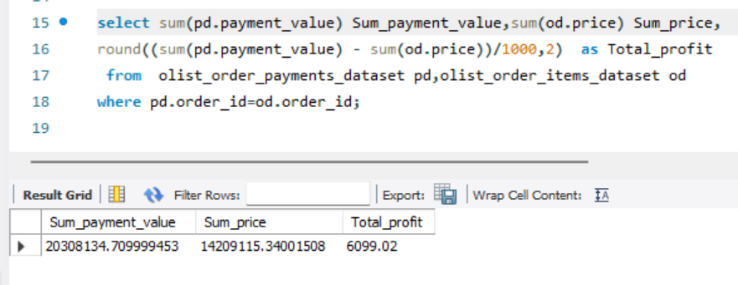
SQL Queries
1. Total Customers
3. Total Sales
2. Total Sellers
4. Total Profit

Slide 14
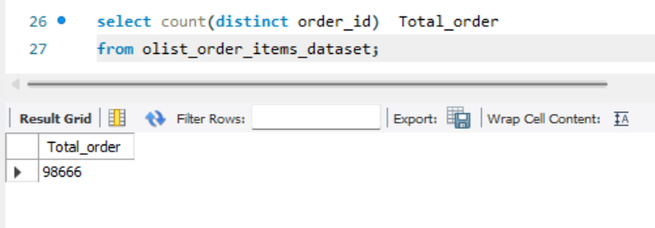
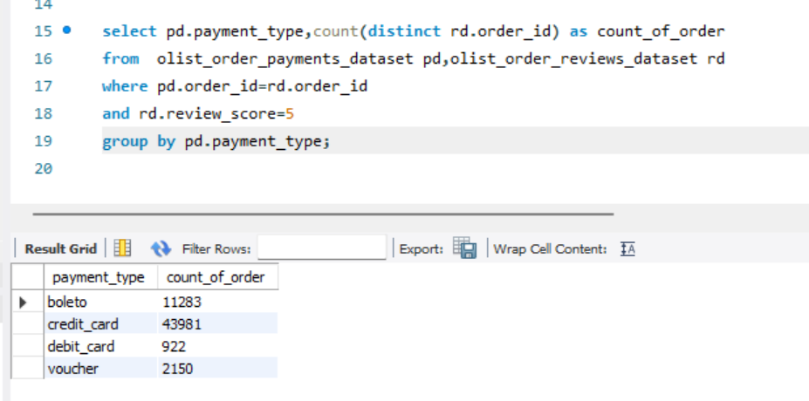
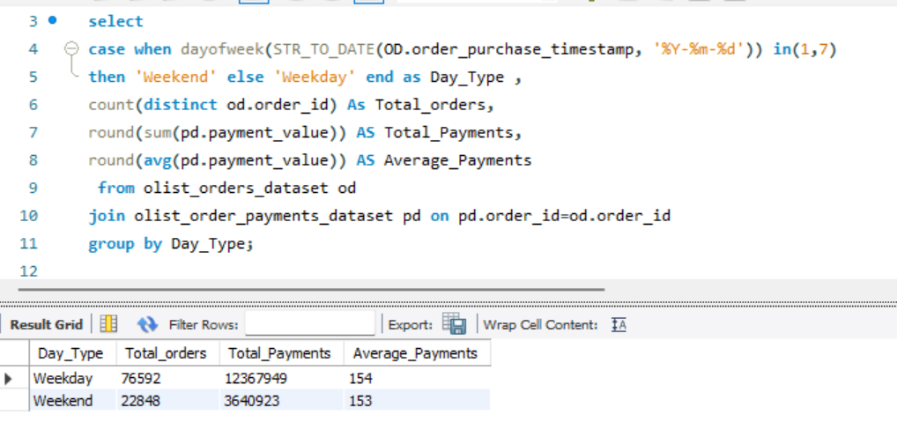
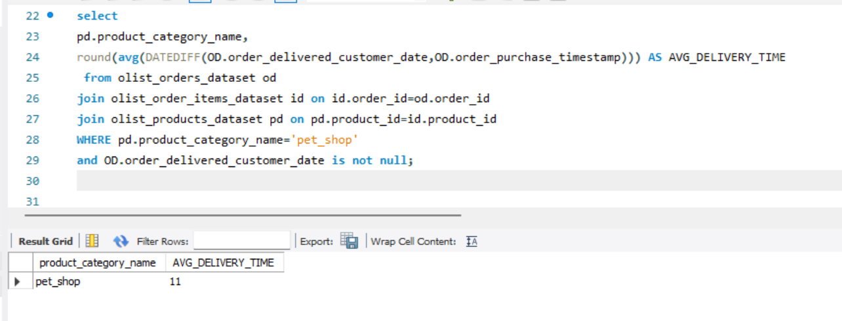
5. Total Orders
7. Number of Orders with review score and payment type.
6. Weekend Vs Weekday Payment :
8. Product Category wise Total delivery Average

Slide 15
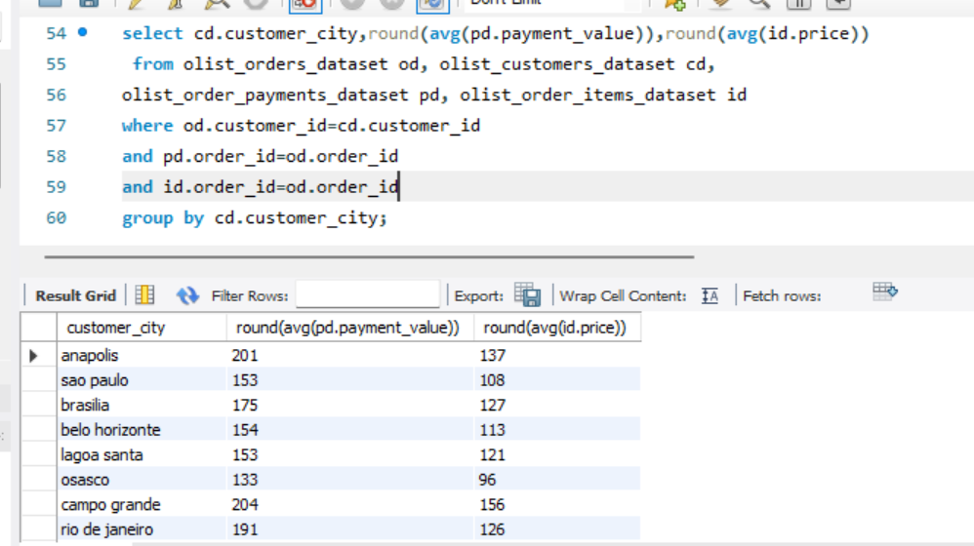
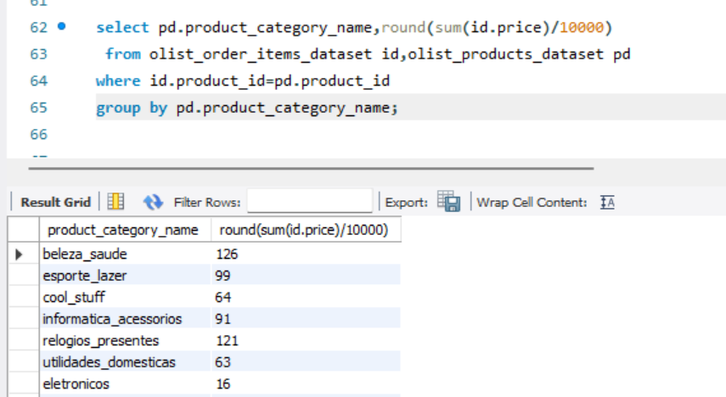
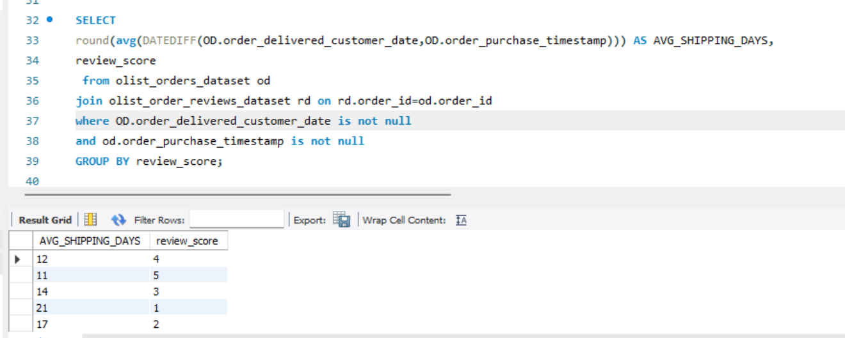
9. City wise Payment Average and Price Average
11. Product Category wise Price
10. Relation Between Shipping days.

Slide 16

CONCLUSION
Overall, regular monitoring of customer reviews, real time tracking of fleet performance together with proper shipment tracking and communication system can improve Olist’s delivery and ensure customers are highly satisfied with the service.
The olist store analysis project provides valuable insights into customer behaviour and payment statistics.
The analysis of these KPIs helps Olist in identifying areas of improvement and creating targeted marketed campaigns.
This project serves as a great example of how data analysis can make help businesses make informed decisions.

Slide 17
Thank You

